Slide 1
Movie Recommendation System
By,
Amith HB 1MS18CS017
D Sanath kumar 1ms18cs037

Slide 2
Introduction
An individual usually has a hard time finding a good movie according to their choice of genre , so we recommend them a list of movies over their ratings or genre or movies that are similar to the one requested and also the list of top rated movies.
We will be using filtering techniques such as Content based filtering and Statistical based filtering to achieve our goal.

Slide 3
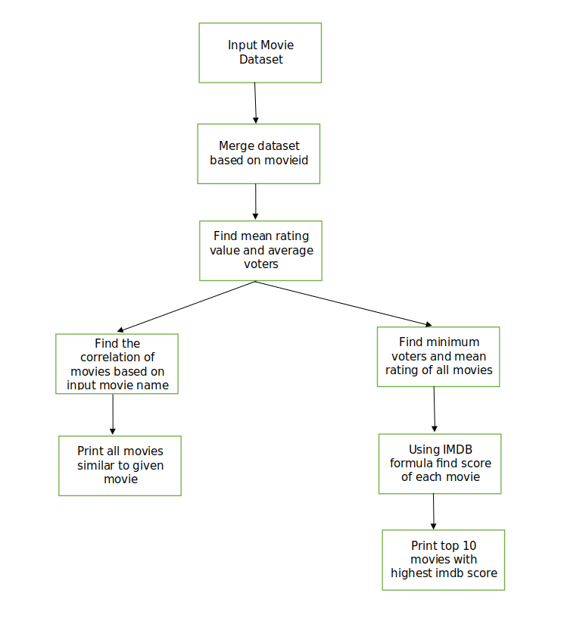
implementation

Slide 4
Contents
Content-based Filtering is a technique that uses similarities in features to make decisions. This technique is often used in recommender systems, which are algorithms designed to advertise or recommend things to users based on knowledge accumulated about the user.
This model is easily scalable due to low amounts of data.
However, this model requires a fair amount of domain knowledge from the people attributing features to products. So, its accuracy is largely dependent on that knowledge being accurate.
In our code we have used content-based filtering to find movies that are similar to the movie searched by the user.

Slide 5
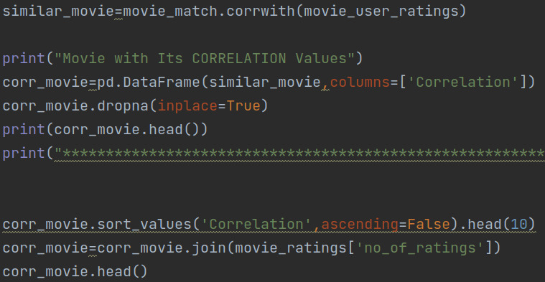
Screenshot

Slide 6
Correlation
The correlation is a numerical values between -1 and 1 that indicates how much two variables are related to each other. Correlation = 0 means no correlation, while >0 is positive correlation and <0 is negative correlation.
We use the corrwith() to obtain this objective.
dropna() method allows the user to analyze and drop Rows/Columns with Null values in different ways
inplace = True , the data is modified in place, which means it will return nothing but the dataframe is updated.

Slide 7
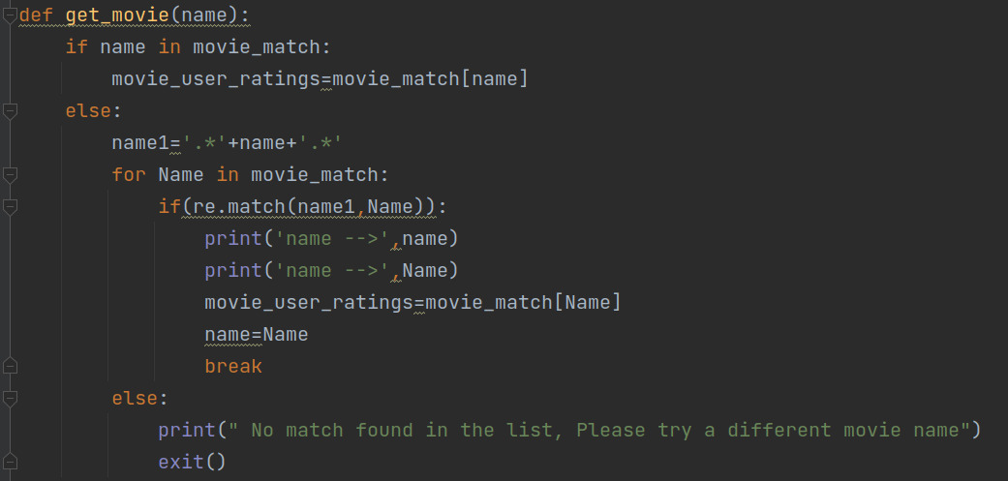
Challenges Faced

Slide 8
Statistical filtering
Here we filter the data obtained by a weight variable i.e., Weighted Rating Which is calculated as ,
(R*v+C*m)/(v+m)
Where,
v : number of votes for a movie
m : minimum number of votes for a movie (75% in our case)
R : rating of the movie
C : mean rating of all the movies

Slide 9
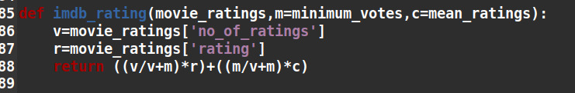
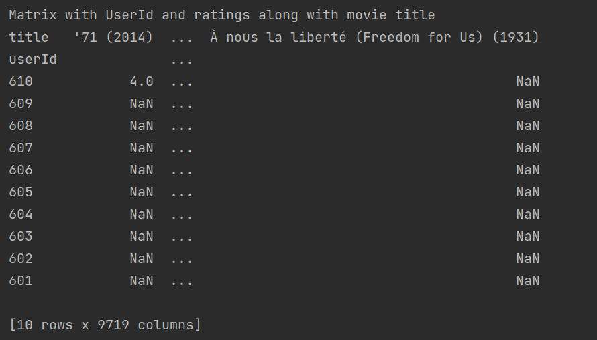
Screenshots

Slide 10
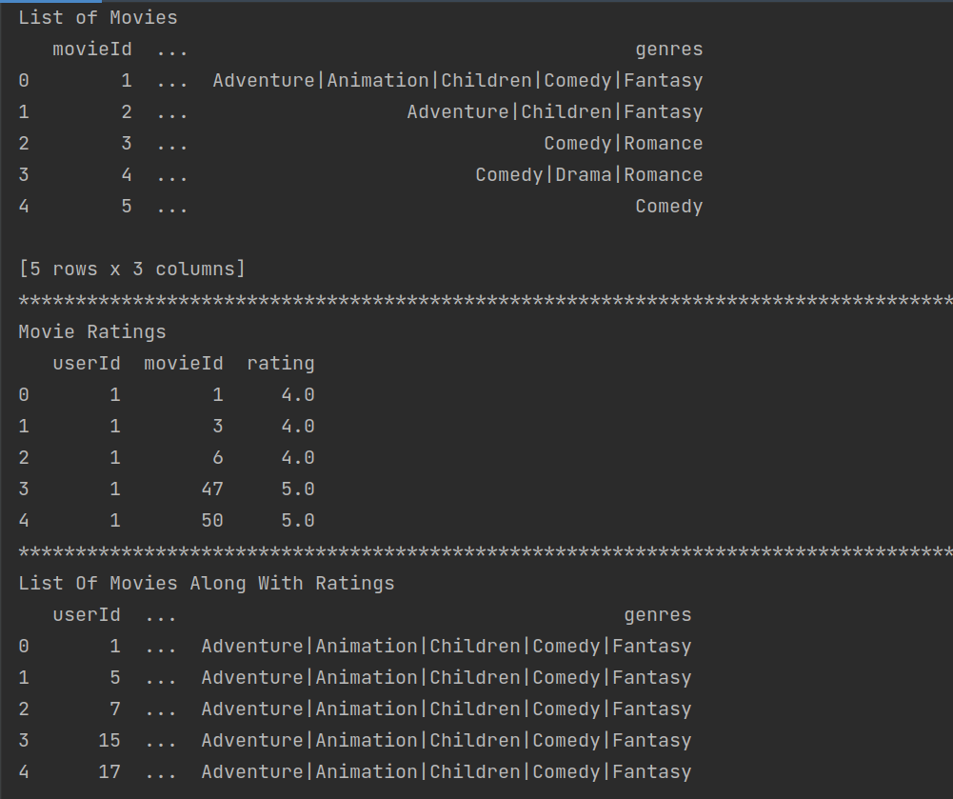
Screenshots

Slide 11
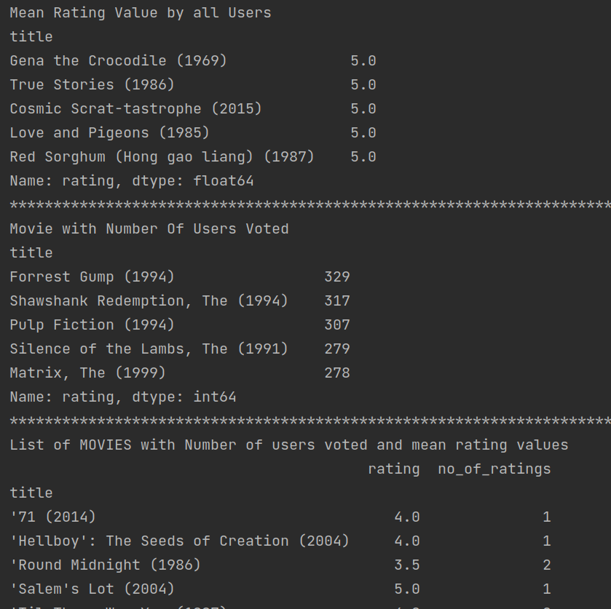
Screenshots

Slide 12
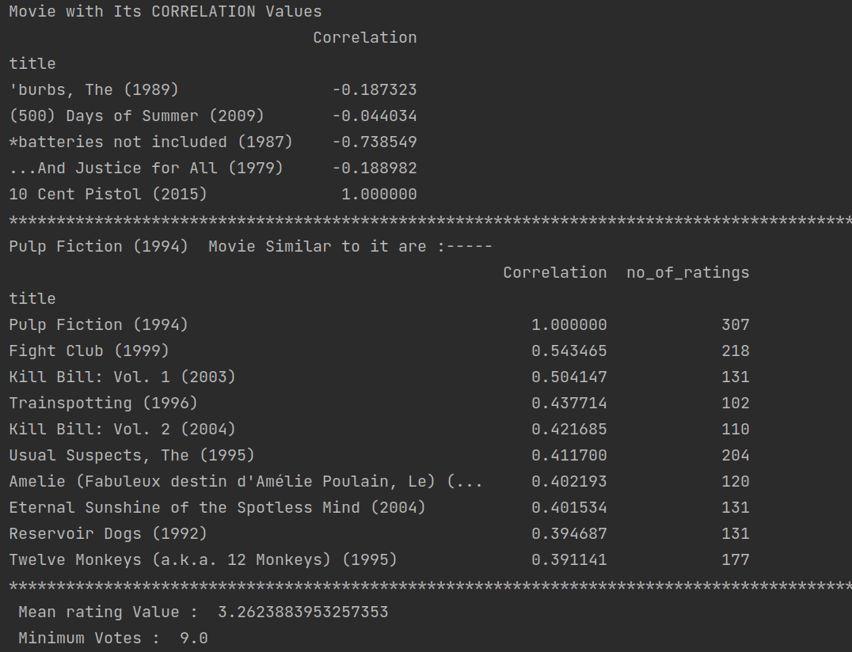
Screenshots

Slide 13
Thank you

